Slide 1
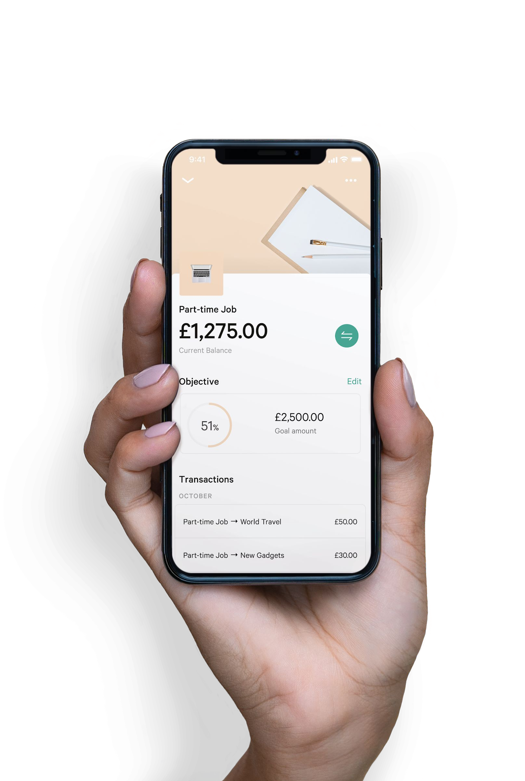
N26 Customer Insights
by Varun Jagannath, Senior Data Scientist

Slide 2

Problem Statement
Can we predict customer’s earnings, expenditures and spending patterns for the next month ?

Slide 3
How will this help to
Bank Customer
→ To know Customer creditworthiness → Gain insights on their money
→ Build better financial products →Insights will help to save money for a goal.

Slide 4
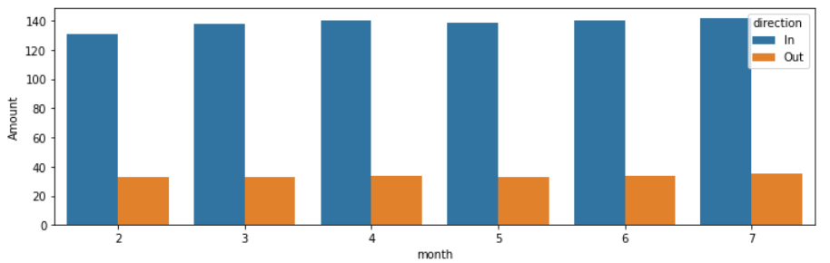
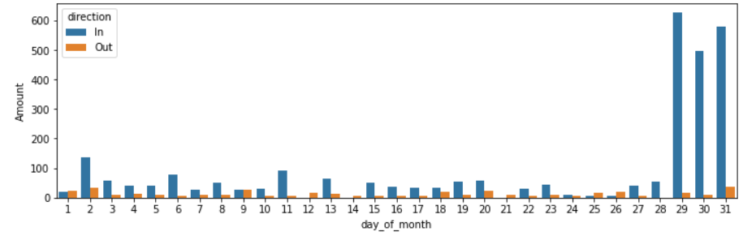
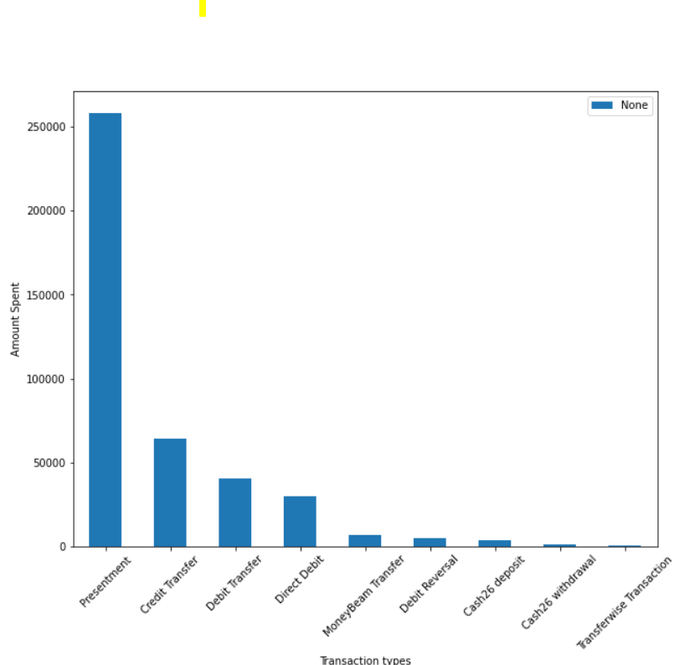
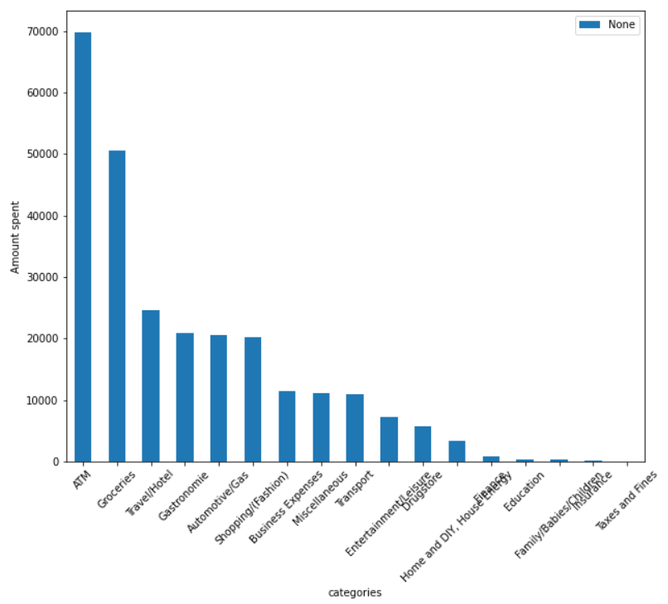
Data Insights
Mean Income & Expense in a month for a sample user
Overall mean Income & Expense per month
It might be salaries getting credited at the end of month
Top transaction types
Top Spending Categories
ATM, Groceries & Travel are among top
Card txns being top most

Slide 5
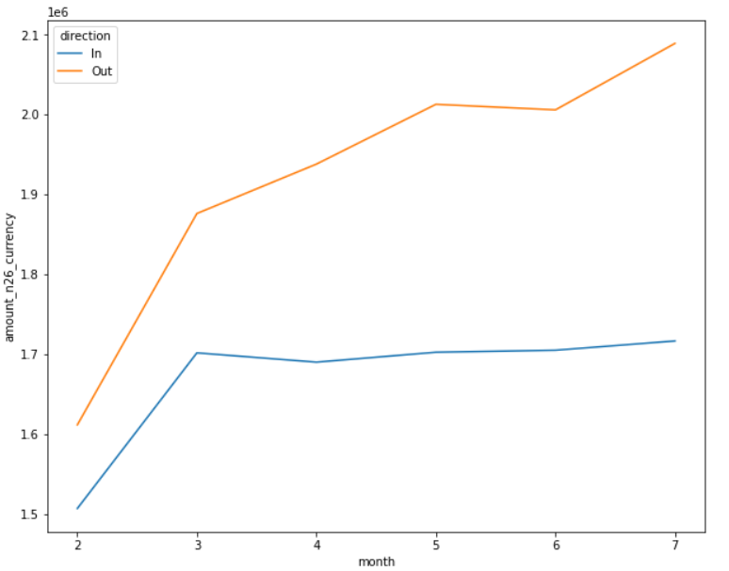
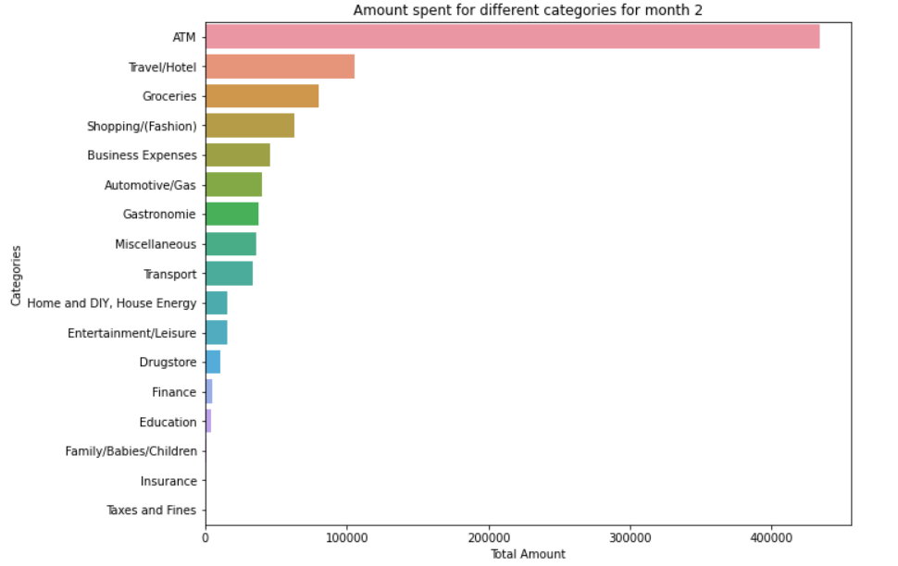
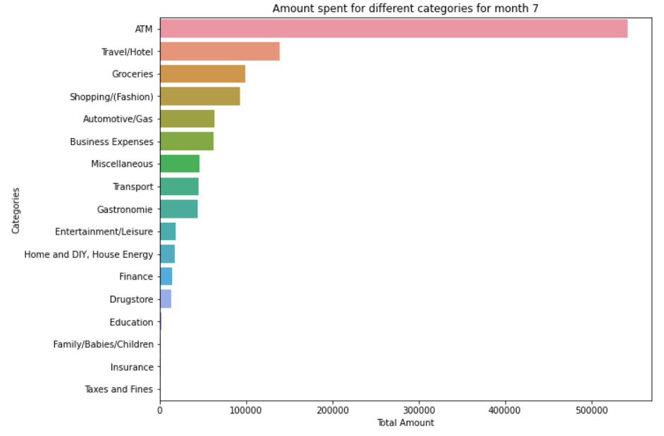
Data Insights
Income & Expense Trend for each month
Top spending categories for February
Gap widens between Income and expense as month progresses
Spending patterns looks similar from Feb to July
Top spending categories for July

Slide 6
Approaches to solve the problem
Income & Expense Model
Spending Categories Model
Assumptions:
Same set of users would be in the next month as well.
Features
Features
Steps:
Label encode user_id and categories.
Use user_id and month as categorical feature in lightgbm
Create aggregate features on amount
Cross validation: GroupKFold on month with 5 splits
Create test set on the amount spent on previous months.
XGBoost
lightgbm
lightgbm
0.5* xgb + 0.5*lgb
Predictions
lgb
Predictions

Slide 7
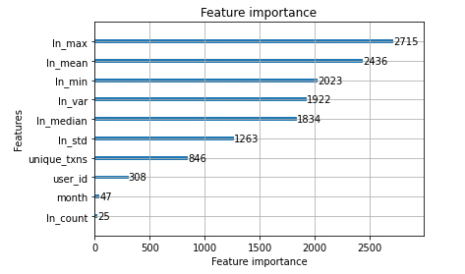
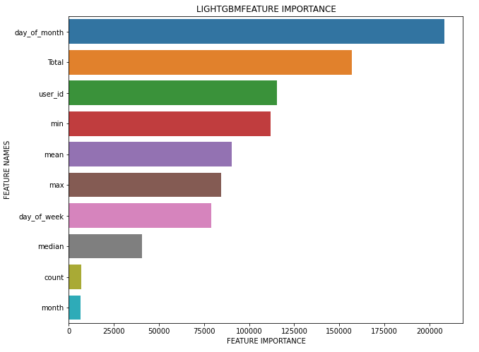
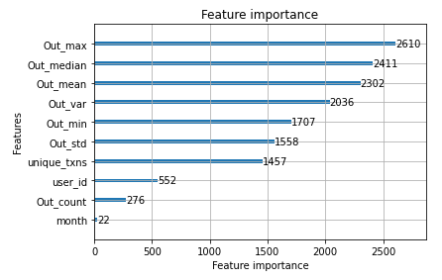
What are my most important features used to predict ?
Features for
Income
Features for categories
Features for Expenses

Slide 8
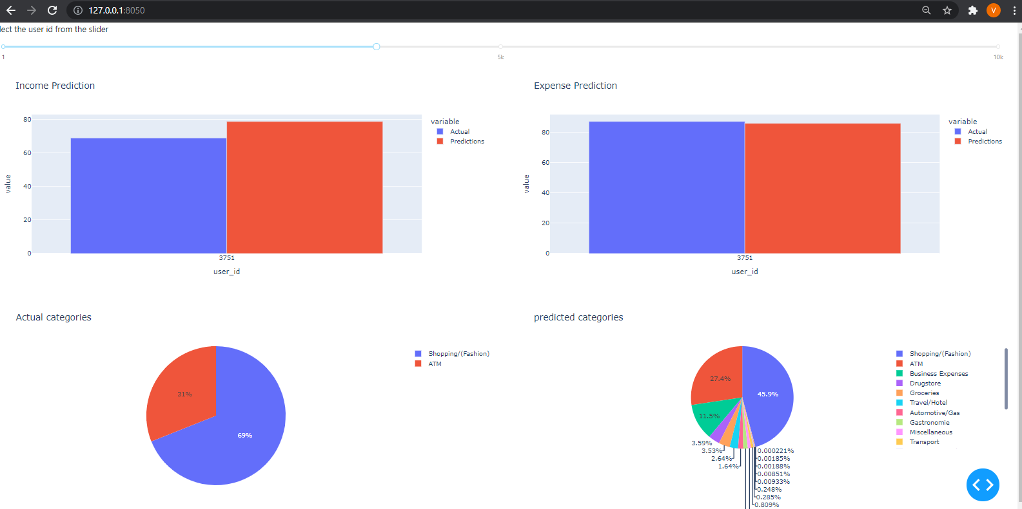
Final Result
Select the user by slider

Slide 9
Metrics
RMSPE on Income
RMSPE on Expense
F1 score
15 %
22 %
0.44
Why theses metrics ?
RMSPE: For example, if actual value is 100 and model predicts as 115, then you can calculate the error in percentage.
F1score (micro average): Since we are predicting multiclass classification with class imbalance.
Note: These are scores on holdout dataset of July.

Slide 10
Release to production
Make batch predictions at the end of month by creating a test set with aggregation on amount as described in dataset class.
Expose an endpoint which will take input as user_id and return the predictions for the future month.

